Slide 1
Brazil-74
Biomass production of forage grasses in response to nutrient use in Brazil
Preliminary Report
Eros Francisco
IPNI - Brazil Program

Slide 2
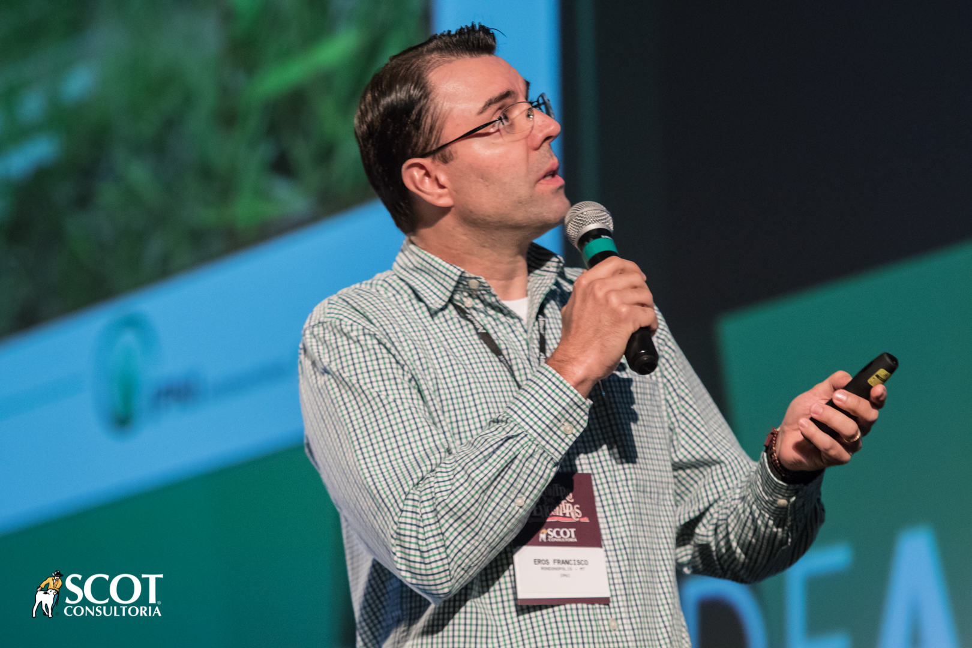
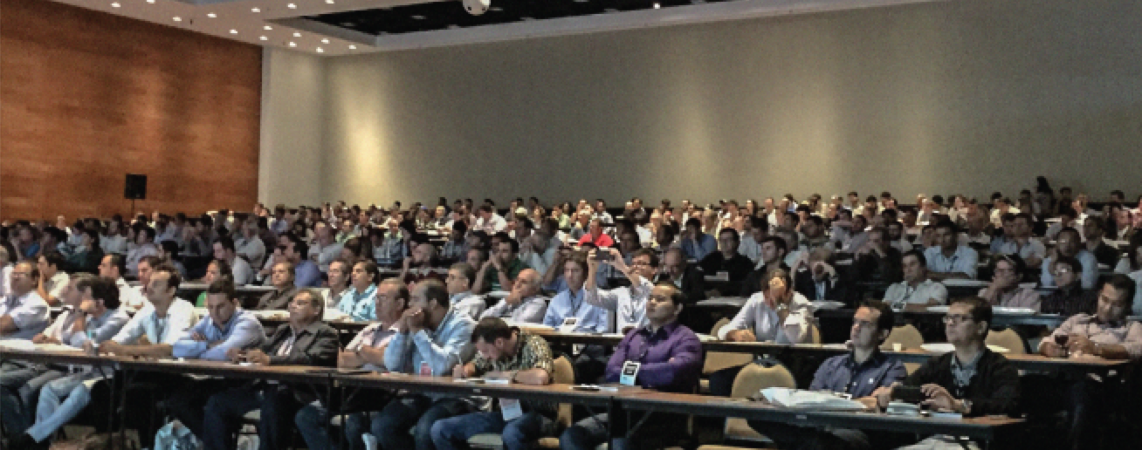
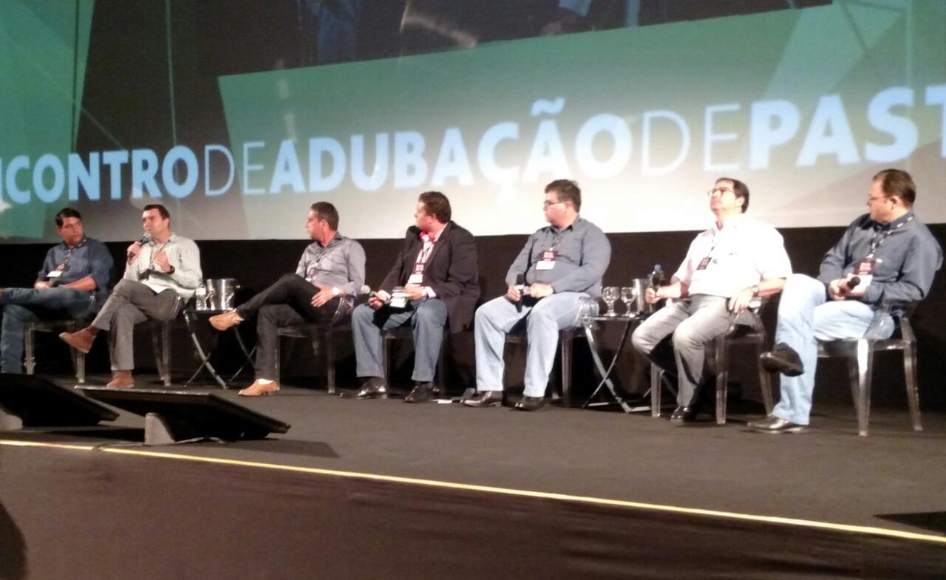
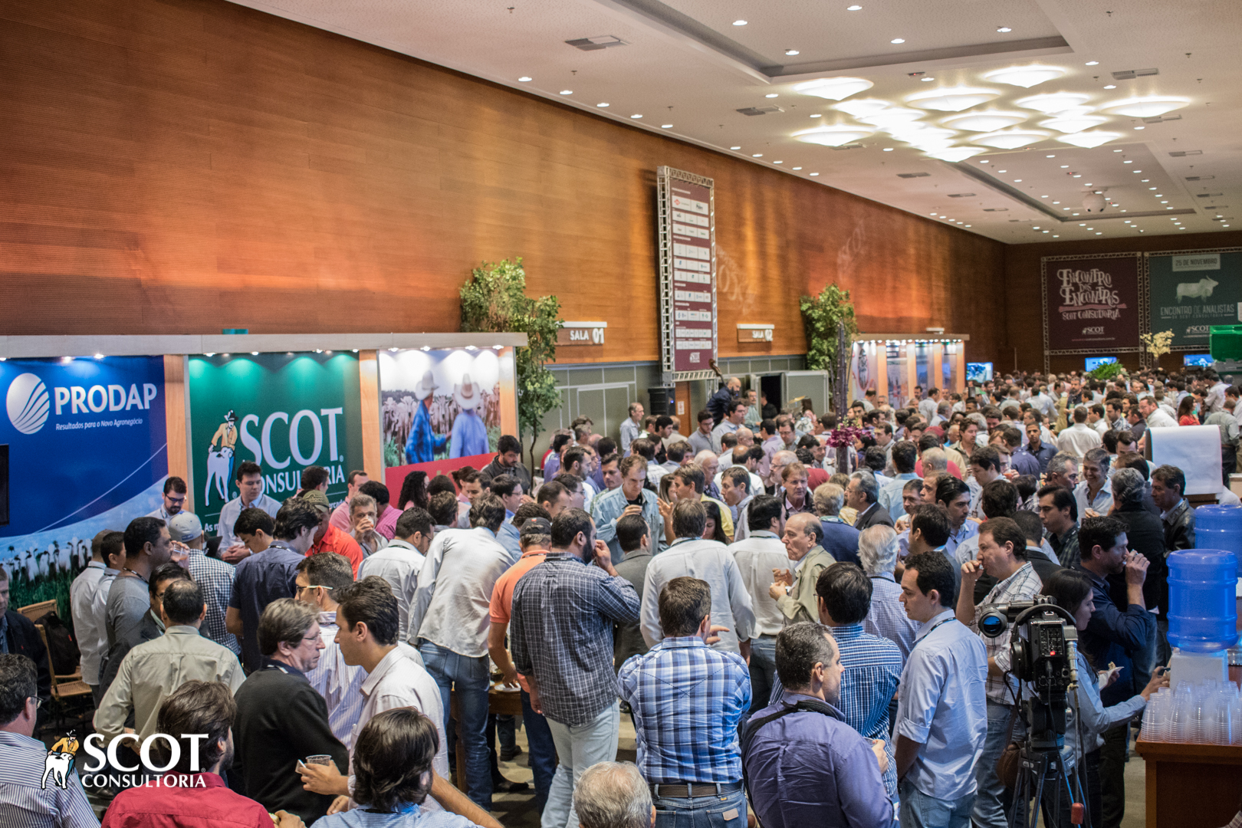
Partnership with Scot Consultoria
Annual meetings on Pastures Fertilization
2014: single presentation (450 attendees)
2015: panel with 3 presentations (500 attendees)
2016: panel with 6 presentations (550 attendees)

Slide 3
Partnership with Scot Consultoria
Annual meetings on Pastures Fertilization
Attendees feedback on the event - 2015
494 attendees from 4 countries (Brazil, Bolivia, Paraguay, and Portugal), 18 Brazilian states, and 155 different cities: 166 questionnaires answered
Size of property: up to 1,000 ha (41%), 1,000 to 5,000 ha (42%), over 5,000 ha (17%)
Size of herd: up to 1,000 heads (37%), 1,000 to 5,000 heads (42%), over 5,000 heads (21%)
64% hire any type of consultation, 89% run soil analysis (70% yearly), 71% apply fertilizers (42% yearly), 64% don’t apply micronutrients, 8% lime the soil yearly
How did you like the event: 92% good or excellent and 8% satisfactory
How did you like the speakers: 97 % good or excellent and 3% satisfactory
How did you like panel 1 (Cattle farming in Brazil, Scot Consultoria): 91% good or excellent and 9% satisfactory
How did you like panel 2 (BPUFs for FG in Brazil, IPNI): 95% good or excellent and 5% satisfactory
How did you like panel 3 (Case studies, Scot Consultoria): 90% good or excellent and 10% satisfactory

Slide 4
Partnership with Scot Consultoria
Annual meetings on Pastures Fertilization
Attendees feedback on the event - 2016
543 attendees from 4 countries (Brazil, Paraguay, Uruguay, and Costa Rica), 18 Brazilian states, and 205 different cities: 160 questionnaires answered
Size of property: up to 1,000 ha (51%), 1,000 to 5,000 ha (33%), over 5,000 ha (16%)
Size of herd: up to 1,000 heads (51%), 1,000 to 5,000 heads (36%), over 5,000 heads (13%)
46% hire any type of consultation, 91% run soil analysis (66% yearly), 74% apply fertilizers (44% yearly), 78% don’t apply micronutrients, 25% lime the soil yearly
How did you like the event: 94% good or excellent and 6% satisfactory
How did you like the speakers: 98% good or excellent and 2% satisfactory
How did you like panel 1 (Fertilizing pastures: what’s for the future, Scot Consultoria): 84% good or excellent and 16% satisfactory
How did you like panel 2 (BPUFs for FG in Brazil, IPNI): 94% good or excellent and 6% satisfactory
How did you like panel 3 (Intensifying beef production, Scot Consultoria): 98% good or excellent and 2% satisfactory

Slide 5
Demonstration Plots
Simple treatments:
Control
Liming (1 t/ha)
Phosphogypsum (2 t/ha)
Liming + N (100 kg N/ha)
Liming + P (100 kg P2O5/ha)
Liming + K (100 kg K2O/ha)
Liming + NPK
Liming + phosphogypsum + NPK
Rolim de Moura/RO
Itiquira/MT
Dracena/SP

Slide 6
Demonstration Plots
Site 1: Dracena, São Paulo. Grass: Brachiaria brizantha cv. Marandu. Installation date: December, 2016.
Site 2: Itiquira, Mato Grosso. Grass: Brachiaria decumbens. Installation date: November, 2016.
Numbers represent the result of two consecutive shoot harvests so far in Dracena, São Paulo, and one in Itiquira, Mato Grosso.

Slide 7
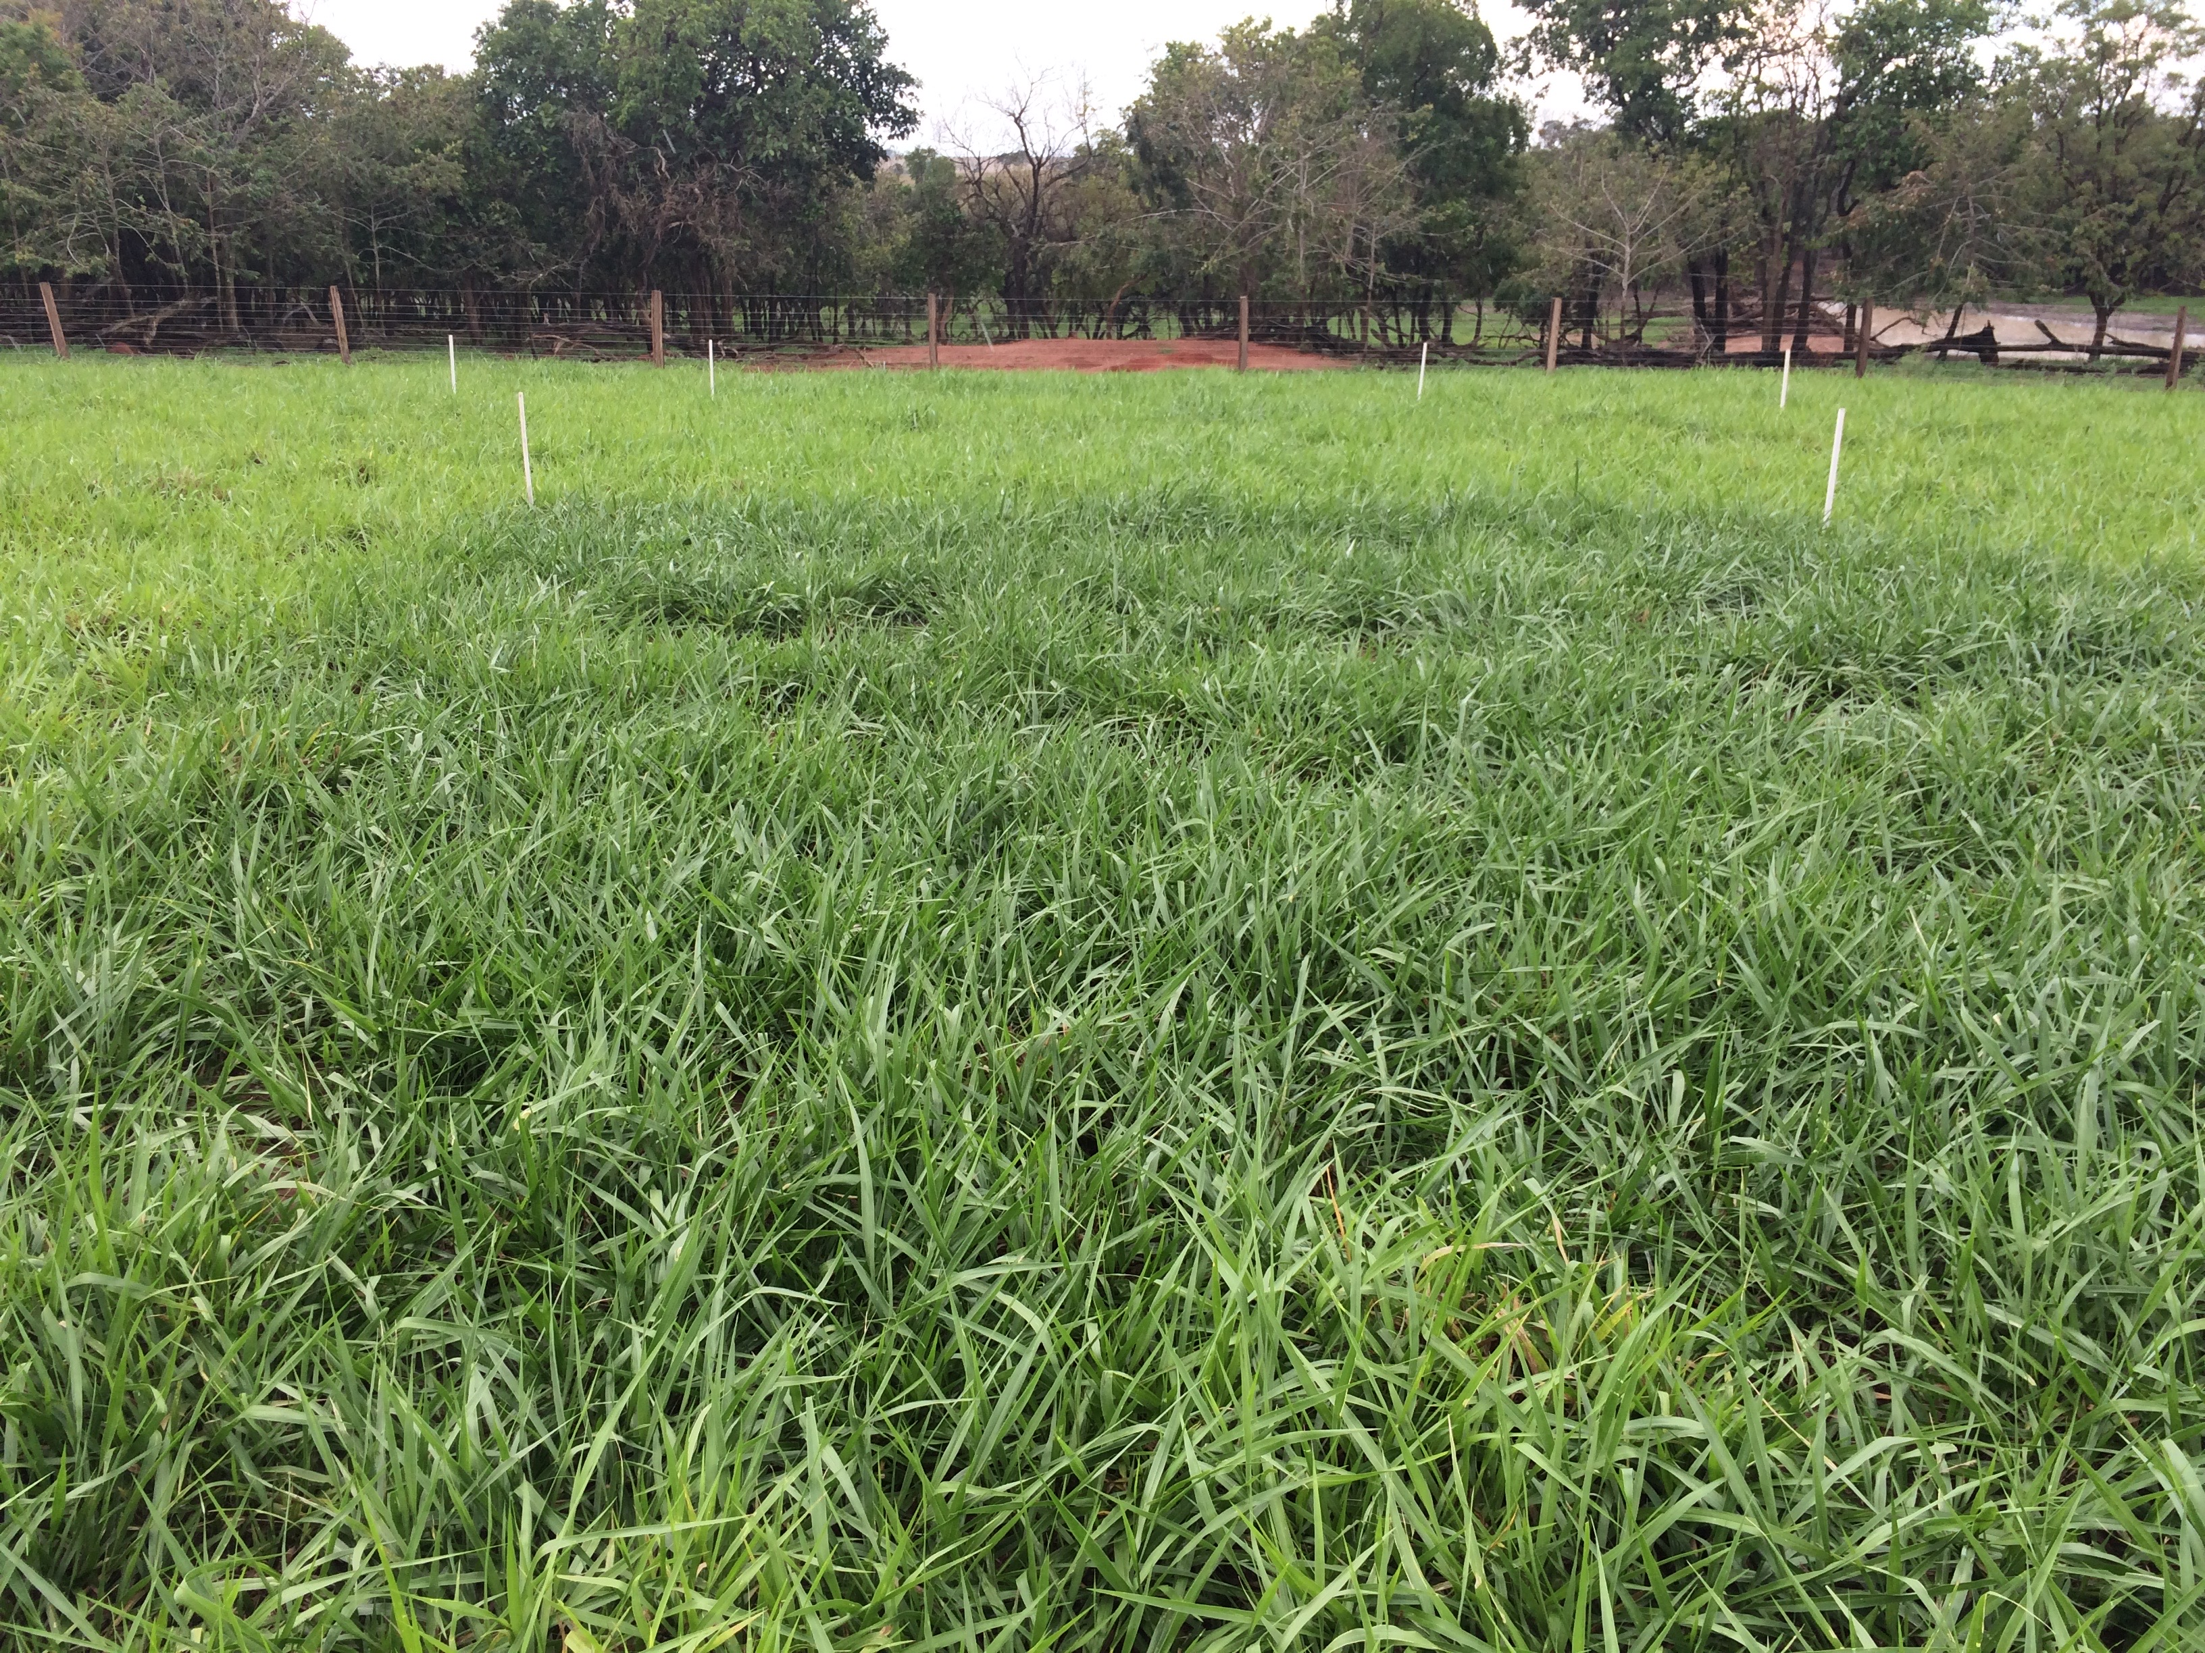
Demonstration Plot
Local: Itiquira, Mato Grosso
Liming + N
(1 week after installation)

Slide 8
Case Study
Local: Jaciara, Mato Grosso
Use of exclosure cages to measure production of forage in semi-confinement fields (herd is not 100% under grain diet). Installation date: Nov, 2016.

Slide 9
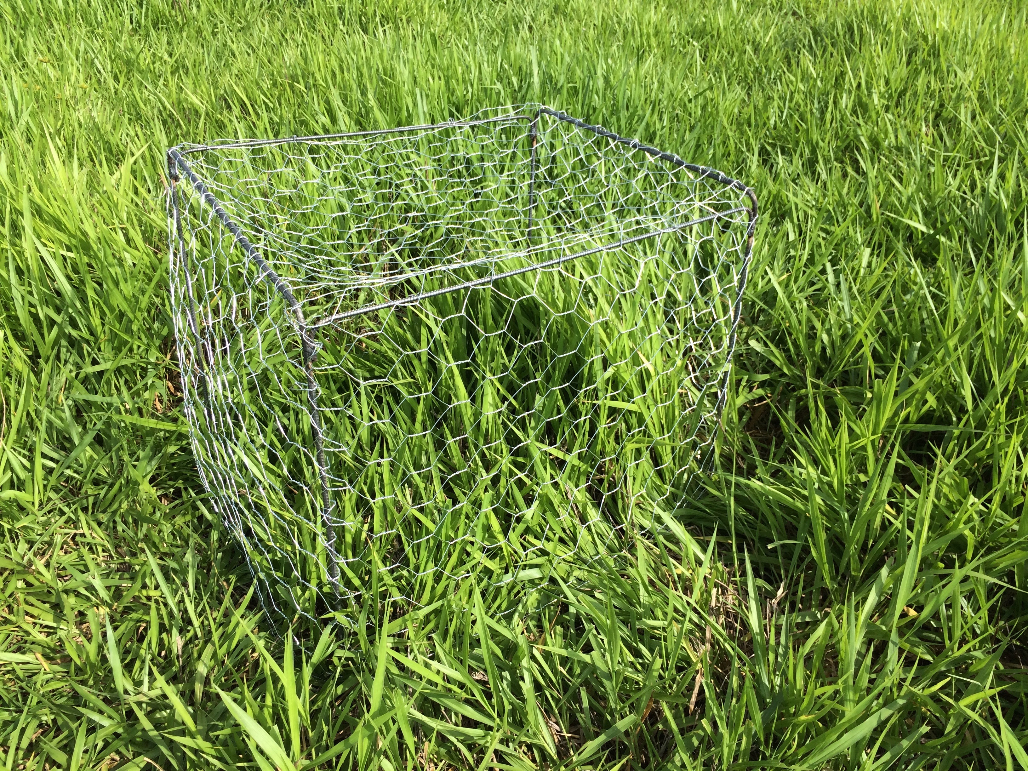
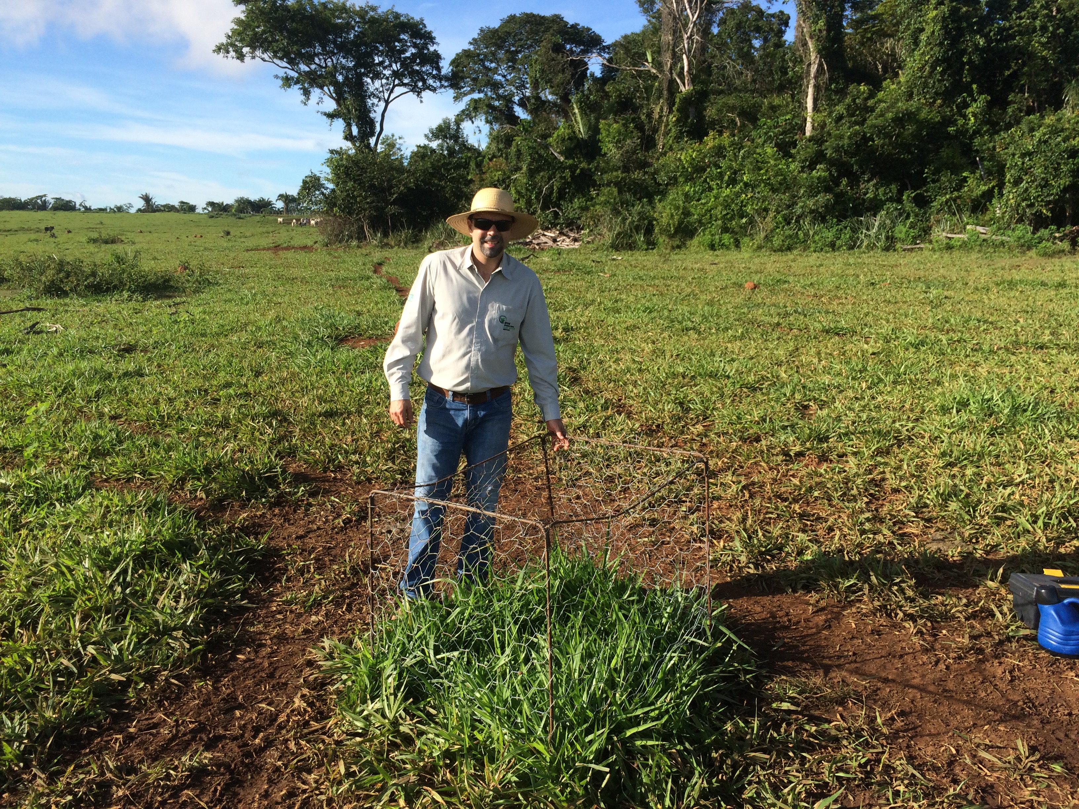
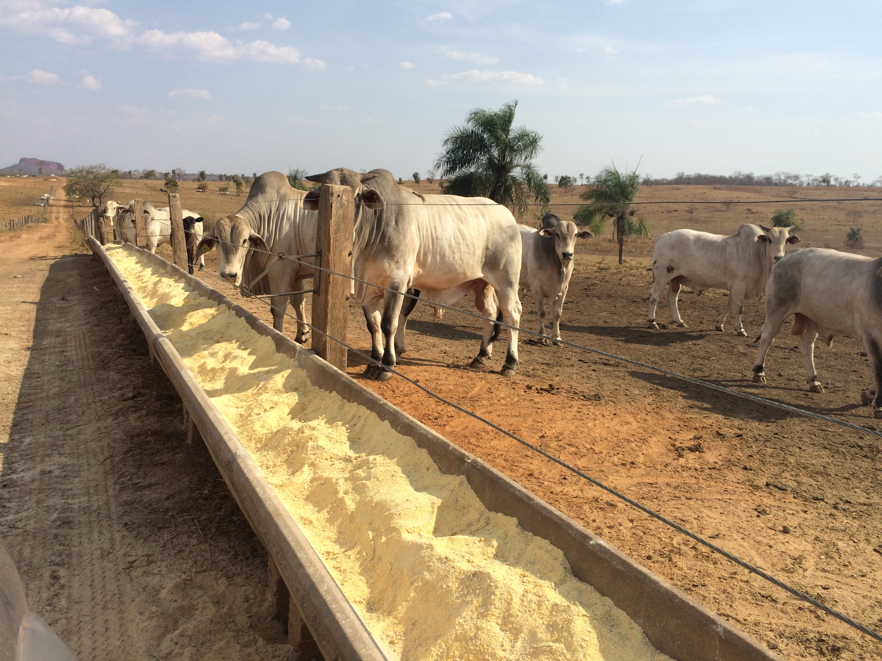
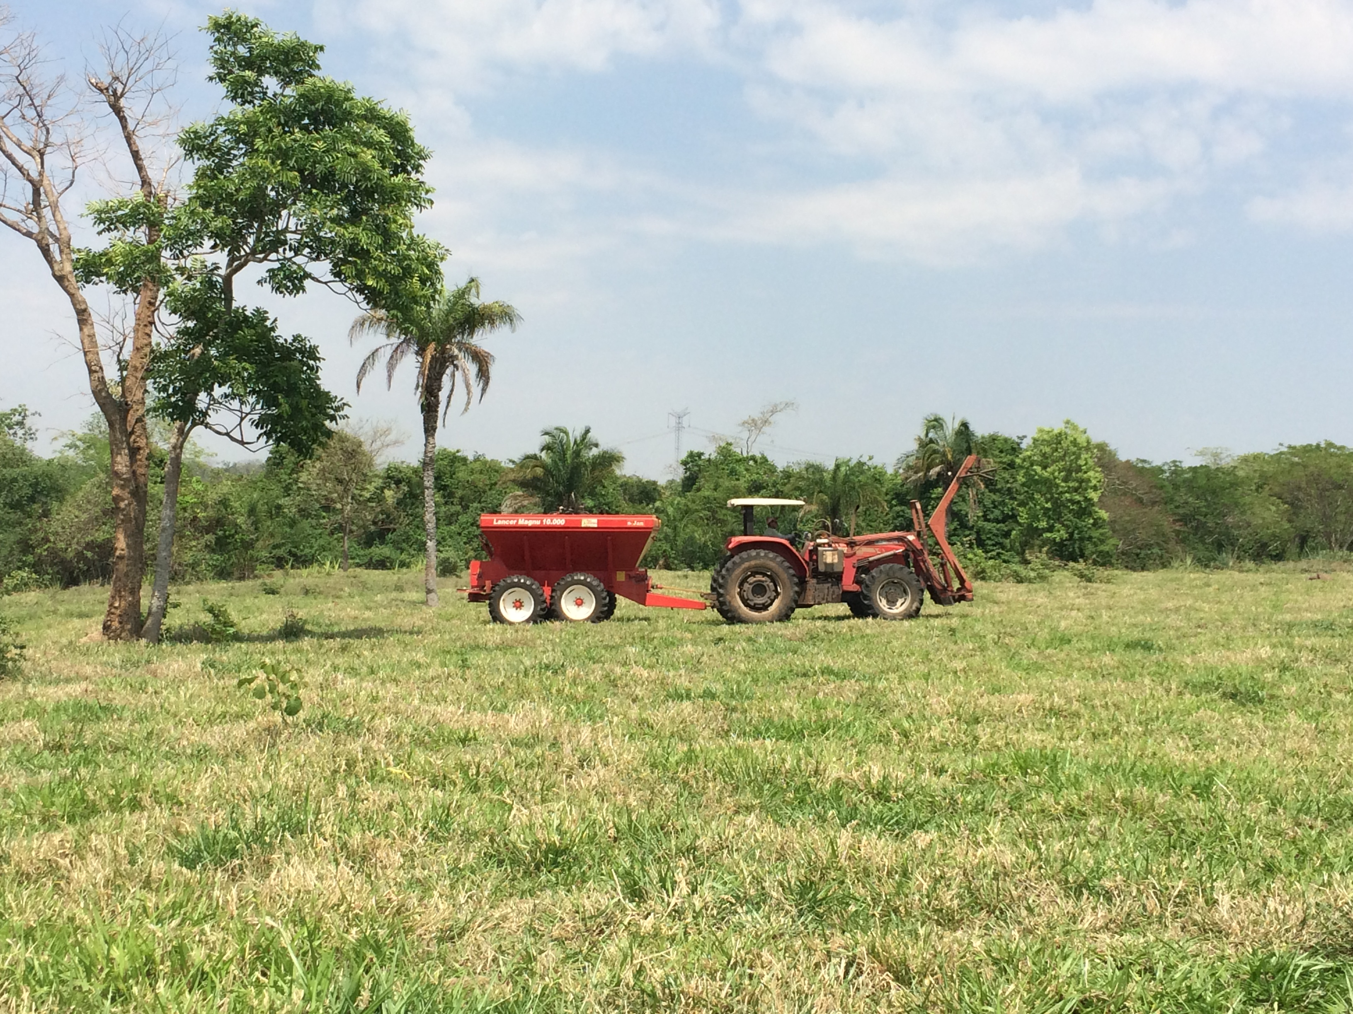
Case Study
Local: Jaciara, Mato Grosso

